Slide 1


MINI PROJECT PRESENTATION
MSc (Five Year Integrated) in
Computer Science (Artificial Intelligence And Data Science)
ASHFAQ HUSSAIN M S (80522003)
28 APRIL 2025

Slide 2
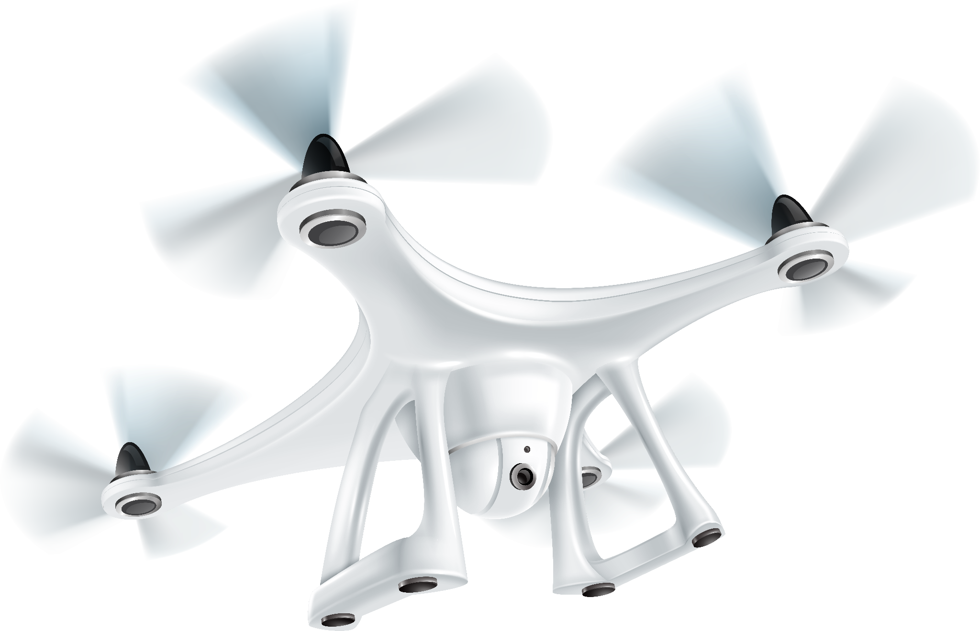
AUTOMATED DRONE OBSTACLE DETECTION AND NAVIGATION USING DEEP LEARNING
DONE BY: ASHFAQ HUSSAIN M S
80522003
6TH SEMESTER
DEP OF COMPUTER SCIENCE
GUIDED BY: DR. PHILIP SAMUEL
SENIOR PROFESSOR
DEP OF COMPUTER SCIENCE

Slide 3

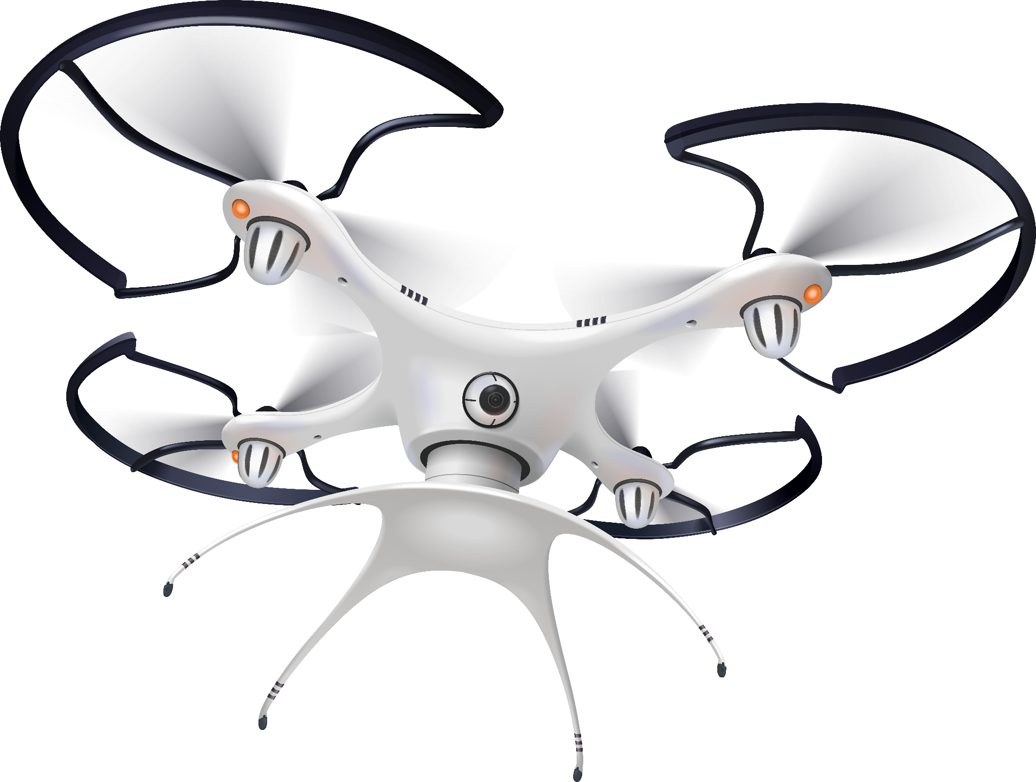
TABLE OF CONTENTS
METHODOLOGY
INTRODUCTION
SCOPE AND APPLICATIONS
LITERATURE REVIEW
MODEL ARCHITECTURE
DATA PREPROCESSING AND ANNOTATION

Slide 4
TABLE OF CONTENTS
FUTURE WORK
TRAINING STRATEGY
RESULTS AND EVALUATION
CHALLENGES AND LIMITATIONS
CONCLUSION
Q/A

Slide 5
INTRODUCTION
Autonomous drones are widely used in surveillance, agriculture, logistics, and disaster management.
PROBLEM STATEMENT :
Autonomous drones are widely used in surveillance, agriculture, logistics, and disaster management.
Real-time obstacle detection and avoidance are crucial for safe navigation.
Drones require robust computer vision systems to accurately detect obstacles in complex environments.
2. MOTIVATION
Manual drone navigation is error-prone and requires skilled operators.
Traditional sensors (LiDAR, Ultrasonic) are expensive and have limitations.
Deep learning models like YOLOv8 and SAM offer powerful, vision-based alternatives for real-time obstacle detection.

Slide 6
INTRODUCTION
Autonomous drones are widely used in surveillance, agriculture, logistics, and disaster management.
3. OBJECTIVES :
Develop a deep learning-based obstacle detection pipeline.
Use YOLOv8 for object detection and SAM for segmentation.
Train on real-world UZH FPV drone dataset.
Automate data annotation and evaluate model performance using mAP, precision, and recall.
Prepare for future integration with SLAM for full autonomy.

Slide 7

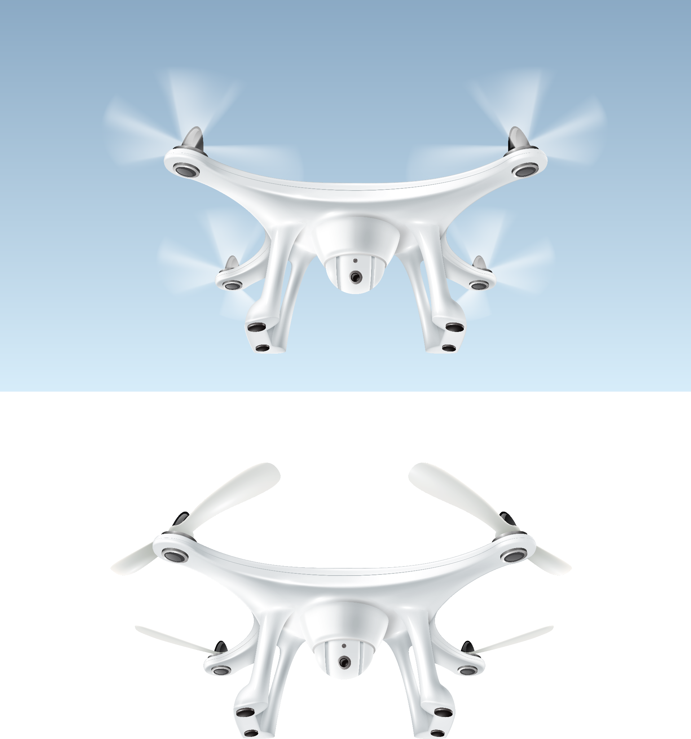
SCOPE
1. SCOPE OF THIS PROEJCT:
Focus on vision-based obstacle detection using only RGB camera data.
Pipeline includes: frame extraction, annotation, model training, and evaluation.
No use of non-visual sensors (e.g., LiDAR, RADAR) to maintain image-based deep learning focus.
Prepares a foundation for future integration with SLAM systems.
Current project does not cover full drone flight deployment — but conceptual roadmap is provided.

Slide 8
APPLICATIONS
1. APPLICATIONS OF THIS PROEJCT:
Autonomous Drone Navigation: Avoid obstacles dynamically in both indoor and outdoor settings.
Search and Rescue: Improve situational awareness in disaster-hit or high-risk areas.
Industrial Inspection: Navigate in hazardous, GPS-denied environments like tunnels or factories.
Surveillance and Security: Enable safer monitoring in unpredictable environments.

Slide 9
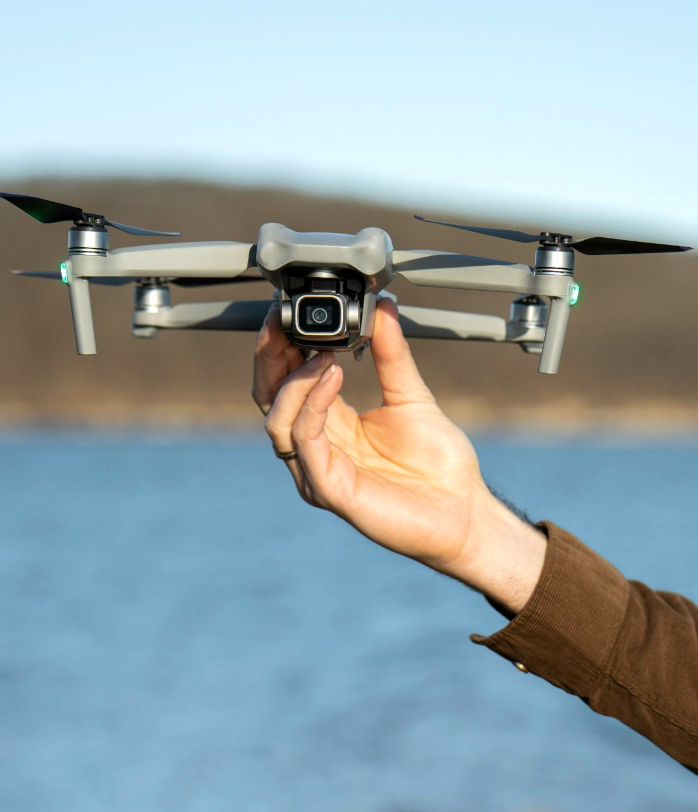
LITERATURE REVIEW
KEY REFERENCES:
Vision-Based Drone Obstacle Avoidance by Deep Reinforcement Learning (Zhihan Xue, Tad Gonsalves, AI Journal, 2021)
Proposed autonomous drone obstacle avoidance using SAC + VAE.
Training done in Airsim simulator using depth maps as input.
Achieved high obstacle avoidance rates (>90%) even in reconfigured environments.
Demonstrated adaptability to new environments without retraining.

Slide 10
LITERATURE REVIEW
LIMITATIONS IDENTIFIED:
Complex setup required (Airsim + Unreal Engine 4 environment).
Time-consuming training process.
Focused only on simulation, not real-world datasets.
ADAPTATION FOR CURRENT PROJECT:
Instead of simulation, real-world UZH FPV drone dataset was used.
YOLOv8 (detection) and SAM (segmentation) applied for efficient obstacle recognition.
Faster, supervised learning approach suitable for practical training without simulated environments.

Slide 11
METHODOLOGY OVERVIEW
DATASET:
UZH FPV Drone Dataset used for training and evaluation provided by Zurich Robotics Group.
Real-world drone flight data: includes indoor and outdoor scenes.
Frame extraction done to prepare images for obstacle detection.
ANNOTATION STRATEGY:
Manual annotation not feasible due to time limits.
Adopted semi-automated pipeline:
YOLOv8 for object detection (bounding boxes).
SAM (Segment Anything Model) for segmentation masks.
Switched from SAM ViT-H to SAM ViT-B model for faster processing.

Slide 12
METHODOLOGY OVERVIEW
MODELS USED:
YOLOv8s and YOLOv8m models selected.
Originally considered YOLOv8x, but shifted to lighter models to handle computational constraints.
Trained models to detect obstacles from drone-perspective images.
OVERALL PIPELINE:
DATA PREPARATION
FRAME EXTRACTION
SEMI AUTOMATED ANNOTATION (YOLOv8s + SAM)
MODEL TRAINING
PERFORMANCE EVALUATION (Precision, Recall, maP)

Slide 13
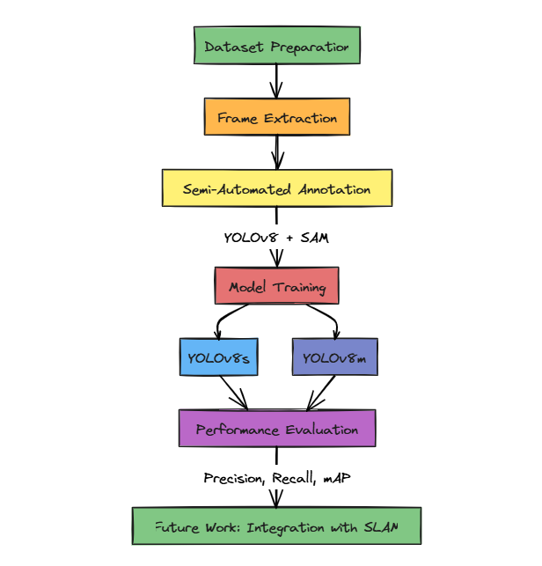
WORKFLOW ARCHITECTURE DIAGRAM

Slide 14
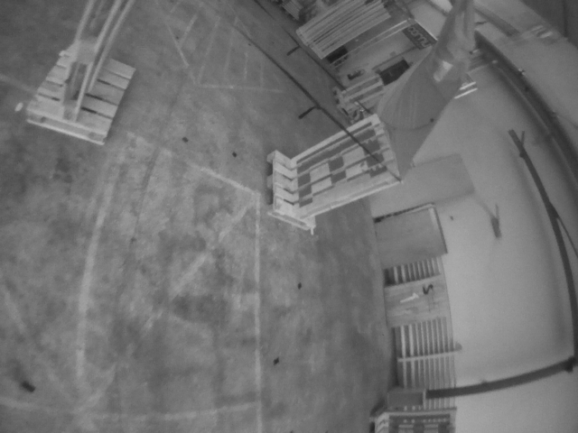
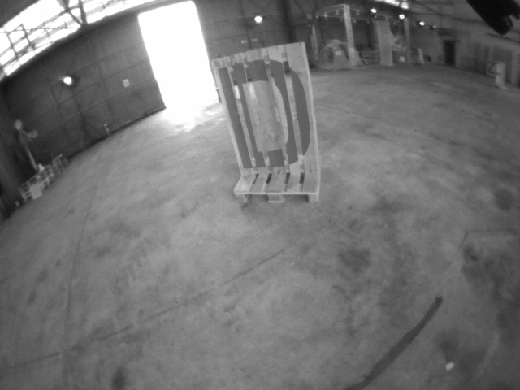
DATA PREPROCESSING
EXPLORATORY DATA ANALYSIS:
INDOOR DOWNWARD SAMPLE
INDOOR FORWARD SAMPLE

Slide 15
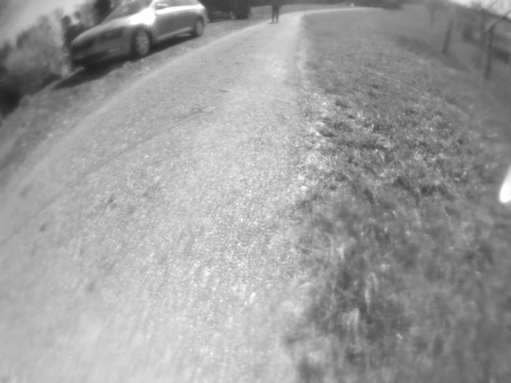
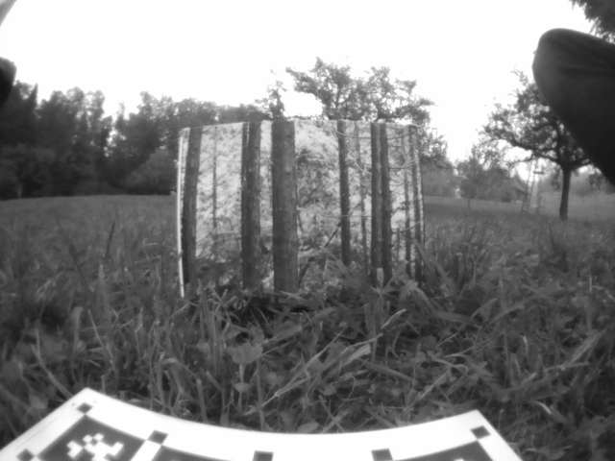
OUTDOOR DOWNWARD SAMPLE
OUTDOOR FORWARD SAMPLE

Slide 16
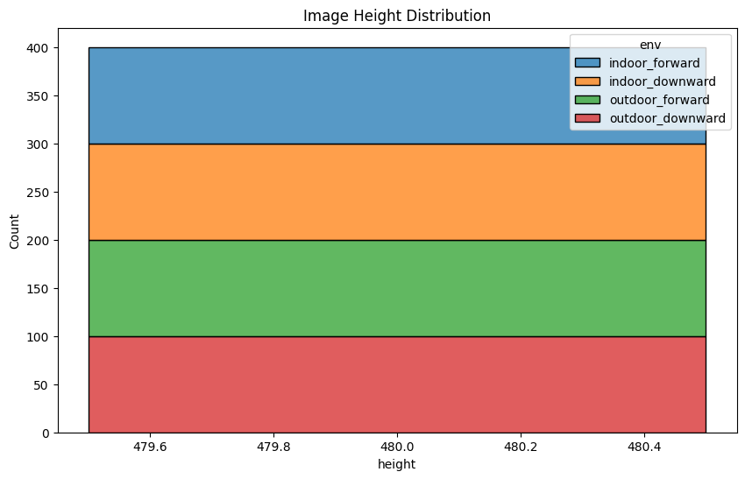
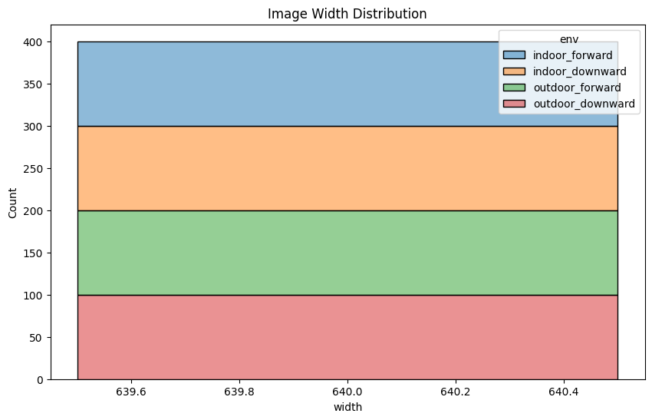
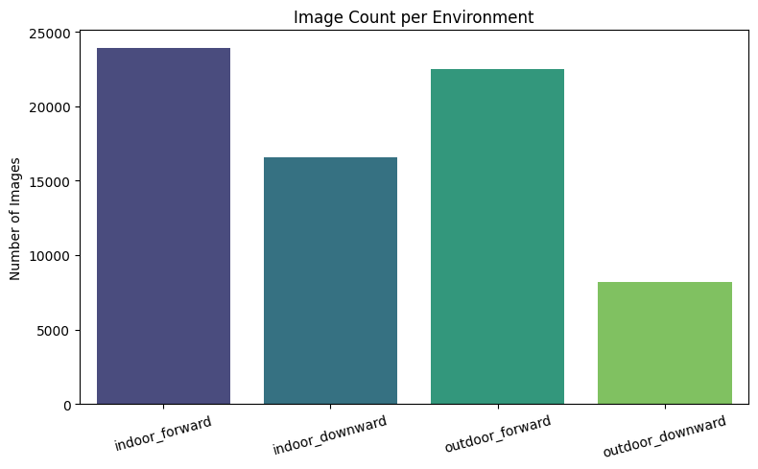

Slide 17
DATA PREPROCESSING
FRAME EXTRACTION:
Extracted frames from multiple environments in the UZH FPV dataset ie, indoor forward, indoor downward, outdoor forward and outdoor downward.
All extracted frames were collected into a single unified folder.
Unified dataset structure made it easier to automate the annotation and training process.
Simplify dataset loading during model training by using a single consolidated folder.
A total of 71,142 frames were extracted.

Slide 18
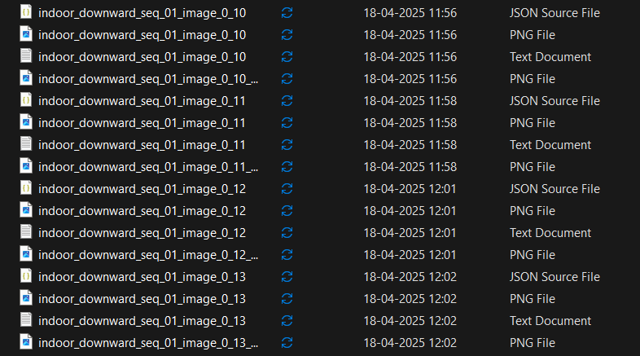
ANNOTATION STRATEGY
Image (.png)
Detection: Used YOLOv8 object detection outputs to create bounding boxes.
Segmentation: Applied SAM (Segment Anything Model) to generate object masks.
Transitioned from SAM ViT_H to SAM ViT_B to reduce computational overhead.
Saved Output – Image(.png), Bounding Box Labels(.txt), Segmentation mask(.png) and Metadata (.json)

Slide 19
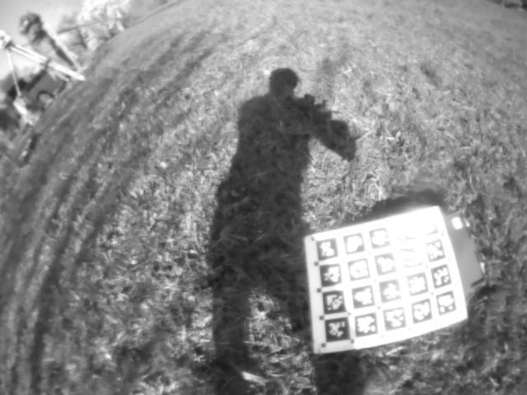
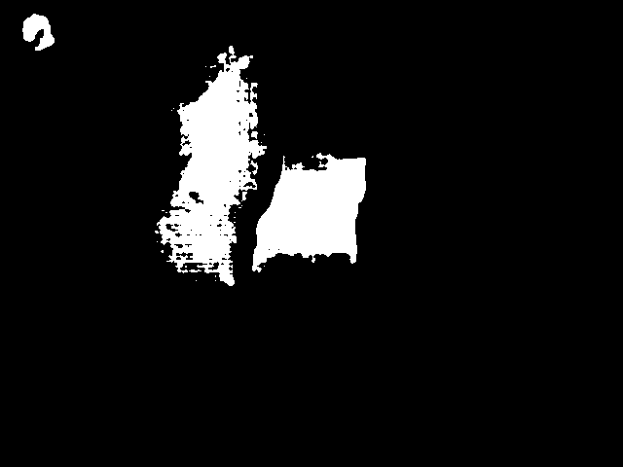
ANNOTATION STRATEGY
Image (.png)
A total of 72 batches of images were annotated each batch containing 1000 images
SAMPLE IMAGE
SEGMENTED MASK

Slide 20
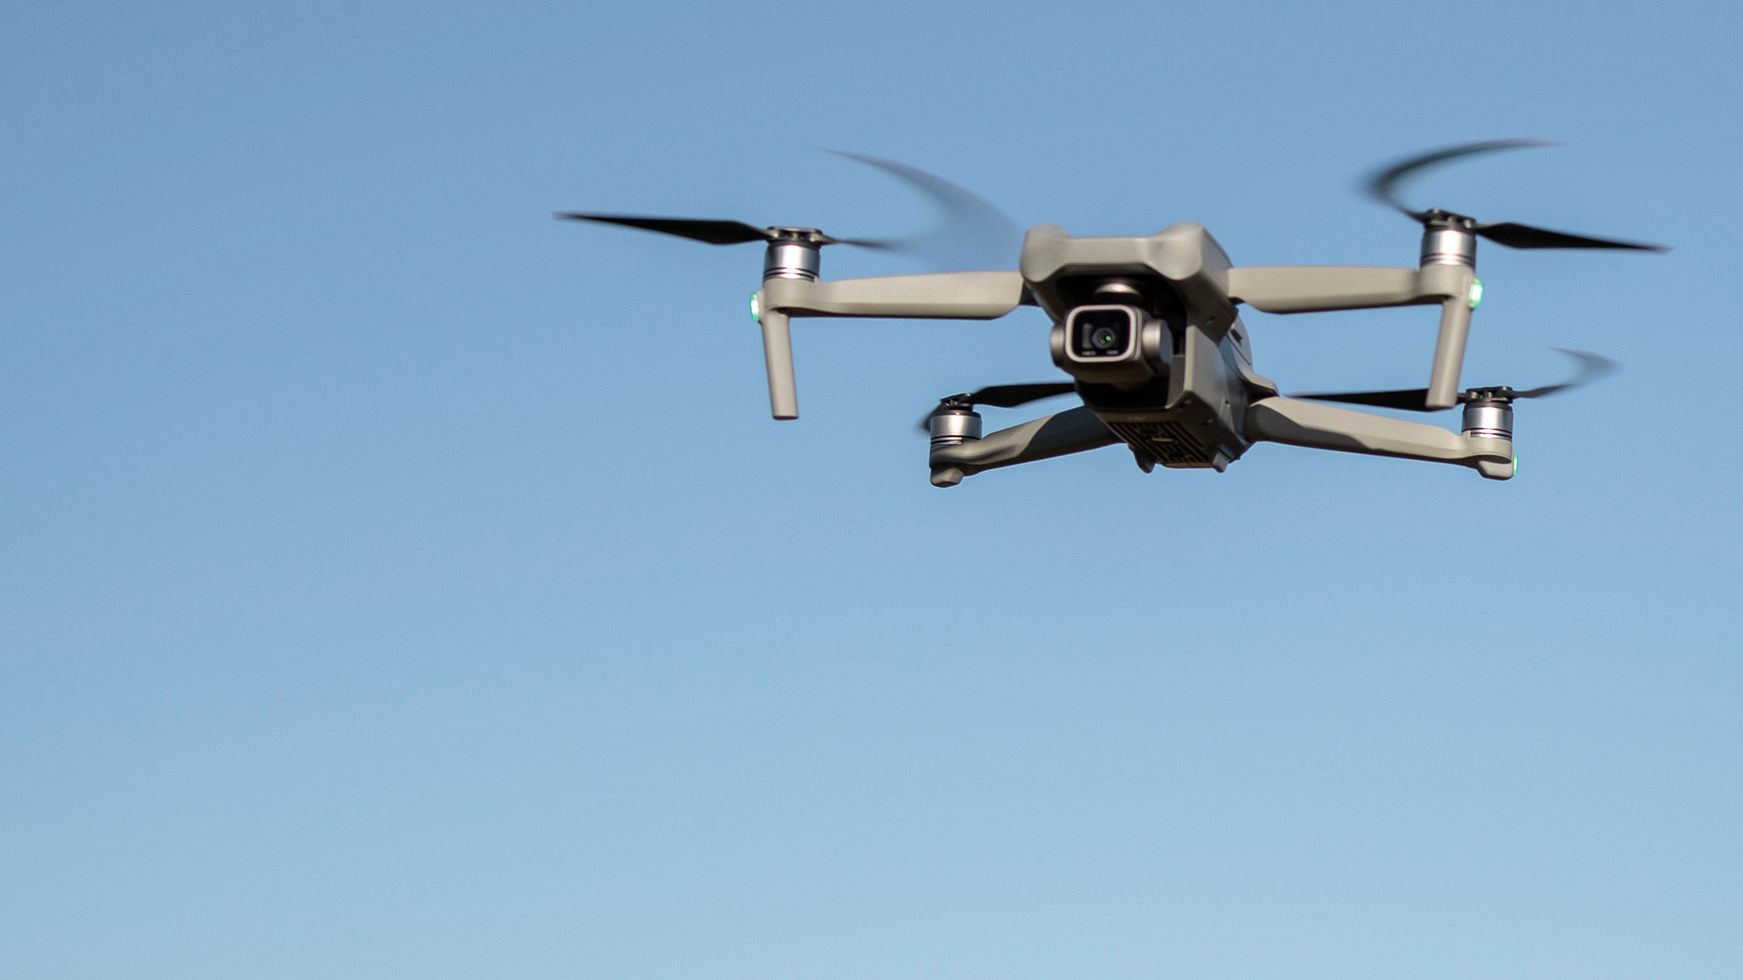
MODEL TRAINING

Slide 21
TRAINING SETUP:
Hardware: High-end GPU (e.g., NVIDIA RTX series)
Frameworks: PyTorch, Ultralytics YOLOv8 library
Input Size: Resized images (default YOLOv8 input dimensions
TRAINING HYPERPARAMETERS:
Batch Size: 8
Epochs: 100 epochs for YOLOv8s and 50 epochs for YOLOv8m
Optimizer: Adam
Learning Rate: Cosine learning rate scheduler used.
Early Stopping: Applied to prevent overfitting.

Slide 22
3. CHECKPOINTING AND VALIDATING:
Model checkpoints saved every few epochs.
Validation metrics (Precision, Recall, mAP) monitored after every evaluation step.
Best-performing model selected based on validation mAP score.
THE DATA WAS TRAINED USING TWO MODELS ONE IS YOLOv8s THE LIGHTEST MODEL AND THE OTHER WAS YOLOv8m.
THE MODELS WERE TRAINED SIMULTANEOUSLY USING TWO DIFFERENT PLATFORMS ONE USING VSCODE AND THE OTHER USING KAGGLE NOTEBOOKS.
BOTH WERE TRAINED WITH DIFFERENT NUMBER OF EPOCHS – 100 EPOCHS FOR YOLOv8s AND 50 EPOCHS FOR YOLOv8m
TRAINING WAS SUCCESSFUL AND THE RESULTS ARE BELOW

Slide 23
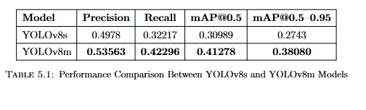
RESULTS & EVALUATION
THE TRAINING RESULTS ARE:
PERFORMANCE HIGHLIGHTS:
YOLOv8m outperformed YOLOv8s in both detection accuracy and robustness.
Model showed strong obstacle detection on medium and large-sized obstacles.
Small or distant obstacles remained challenging (common in drone views).

Slide 24
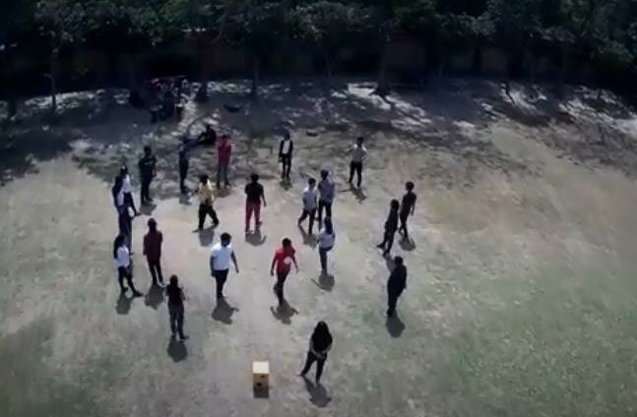
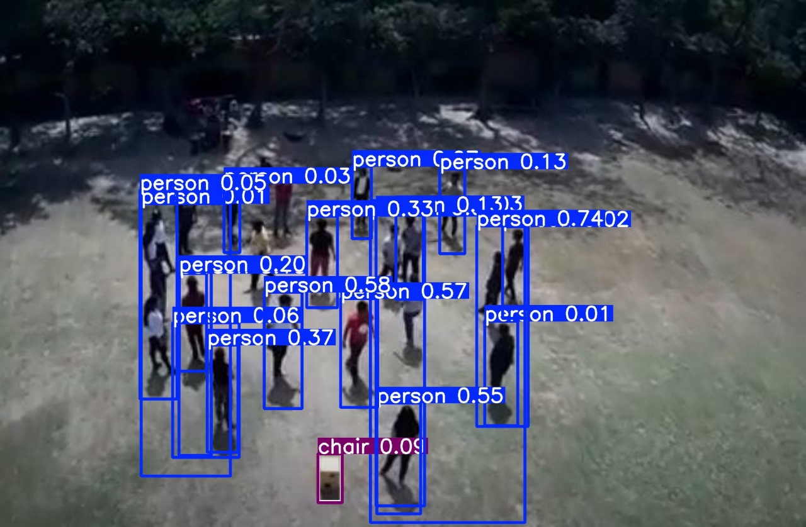
SAMPLE TESTING
TEST INPUT
TEST OUTPUT

Slide 25
CHALLENGES AND LIMITATIONS
DATASET CHALLENGES:
Public drone datasets focused on obstacle detection are limited.
UZH FPV dataset are unlabeled and required frame extraction and manual filtering.
Large extracted dataset size caused storage and management issues.
ANNOTATION CHALLENGES:
Manual labeling infeasible due to time constraints (~70,000+ frames).
Semi-automated annotation pipeline (YOLOv8 + SAM) adopted.
SAM segmentation occasionally produced imperfect masks, especially for small/overlapping objects.
YOLO limited to COCO classes; obstacles like trees are often unrecognized.

Slide 26
CHALLENGES AND LIMITATIONS
3. COMPUTATIONAL CHALLENGES:
Heavy models like YOLOv8x were resource-intensive; switched to YOLOv8m and YOLOv8s.
Training required careful resource planning (GPU, memory, disk space).
Checkpoint saving and validation steps consumed extra time and storage.
OVERALL SYSTEM LIMITATIONS:
Difficulty in detecting very small/distant obstacles.
Minor errors introduced by automated annotations.
Need for real-time optimization (e.g., TensorRT) for live drone deployment.

Slide 27
FUTURE WORK
MODEL OPTIMIZATION
Apply model compression techniques like pruning, quantization, and TensorRT optimization to achieve real-time performance.
Explore lightweight object detection models (e.g., YOLO-Nano, YOLOv8n) for faster inference on drones.
Try to use YOLOv8x with more compute resources.
CUSTOM DATASET EXPANSION
Collect and annotate custom obstacle datasets to cover more rare obstacle types (e.g., drone parts, small debris).
Improve annotation quality to further boost detection precision.

Slide 28
FUTURE WORK
3. INTEGRATION WITH SLAM SYSTEMS
Combine obstacle detection with Visual SLAM (Simultaneous Localization and Mapping) for autonomous drone navigation.
Real-time mapping + obstacle detection = complete autonomous flight capability.
4. REAL WORLD DEPLOYMENT
Deploy trained model onto real drone hardware (e.g., PX4 Autopilot + NVIDIA Jetson platform).
Conduct outdoor and indoor real-world testing under varied environmental conditions.

Slide 29
CONCLUSION
Successfully developed a vision-based drone obstacle detection system using YOLOv8 and SAM.
Achieved promising detection performance, but challenges remain in small obstacle detection and annotation noise.
Computational constraints led to model simplification (YOLOv8m and YOLOv8s).

Slide 30
Q/A
THANK YOU

